Slide 1
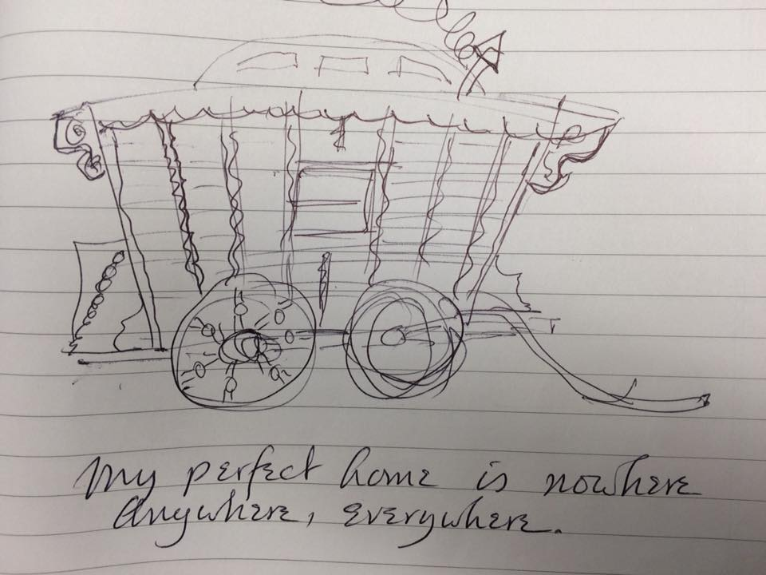
Poetry with an accent
© Poem “Frontera” (“Border” by C.Lema)

Slide 2
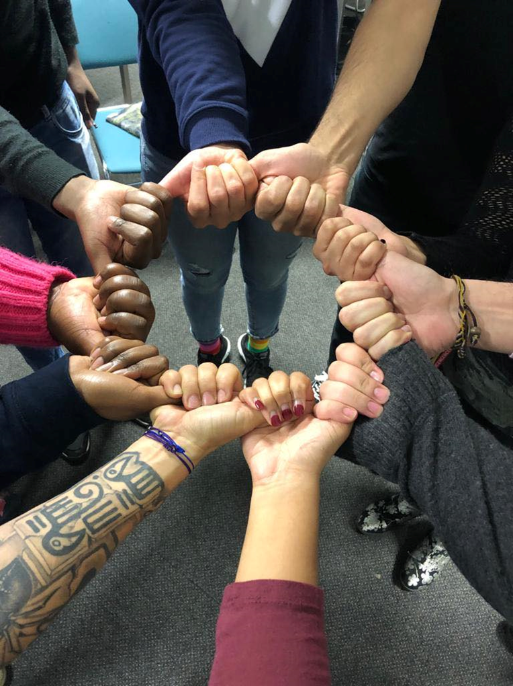
Newham Poetry Group’ (hi)story
“I am different but not a stranger…I am a poet”

Slide 3
Poetry demolishes language barriers and cultural differences when it is based in open and honest exchanges between participants
“Belonging is the condition to be understood”
Artistic expressions msut be decolonised and we must avoid using Eurocentric approach.
“Poetry is a language in itself and when used in a safe and welcoming environment it can be a bridge that connects our differences and acknowledges our similarities.

Slide 4
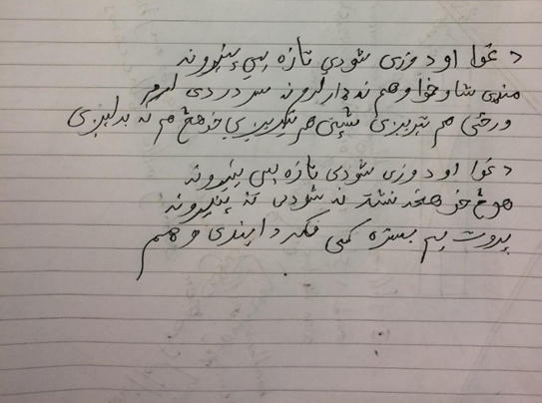
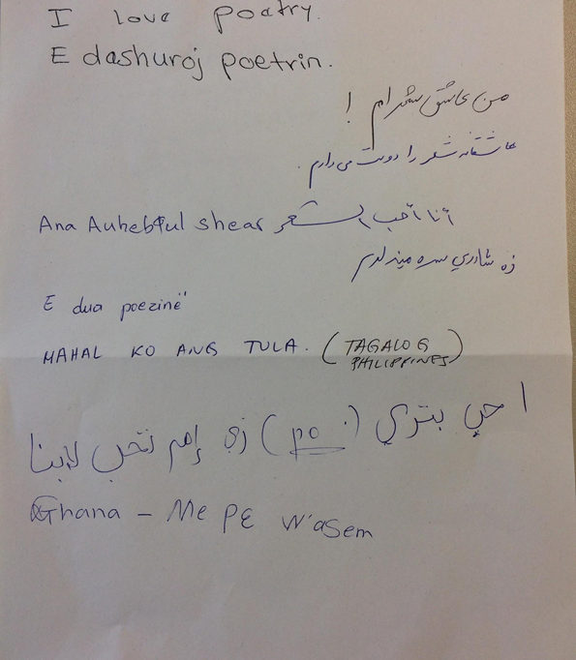
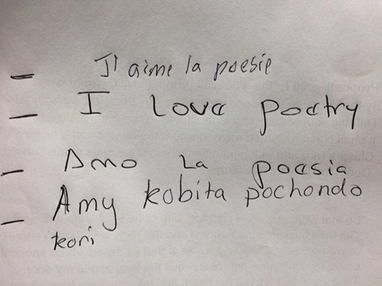
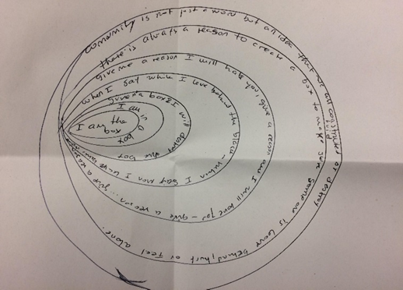
Poems:
We Are Poets
We are the ones
Who feel the sting of loss,
The pain and misery of life;
Connected by allowing our emotions,
By not hiding far behind
Rehearsed smiles,
But sharing our frowns as they emerge.
At home,
We might be mothers, sons or wives,
We might be English, German, Spanish, other, We might be teachers, nurses, men in suits,
Who come from places of divorce
Or happy hearths.
We might be all and more when we're away,
But here, we're poets sharing poetry.

