Slide 1
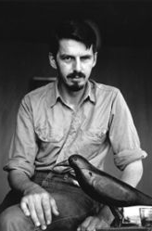
Painting by numbers: ecological consciousness in Creeley's Pieces Nick Selby, University of East Anglia

Slide 2
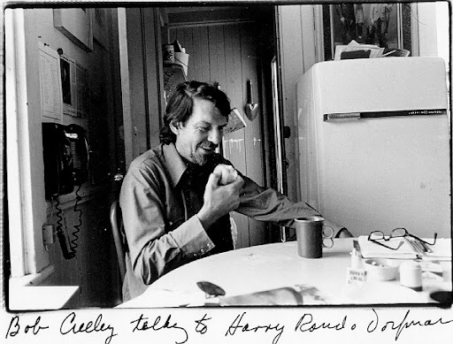
from ‘A Step’ Cup. Bowl. Saucer. Full.

Slide 4
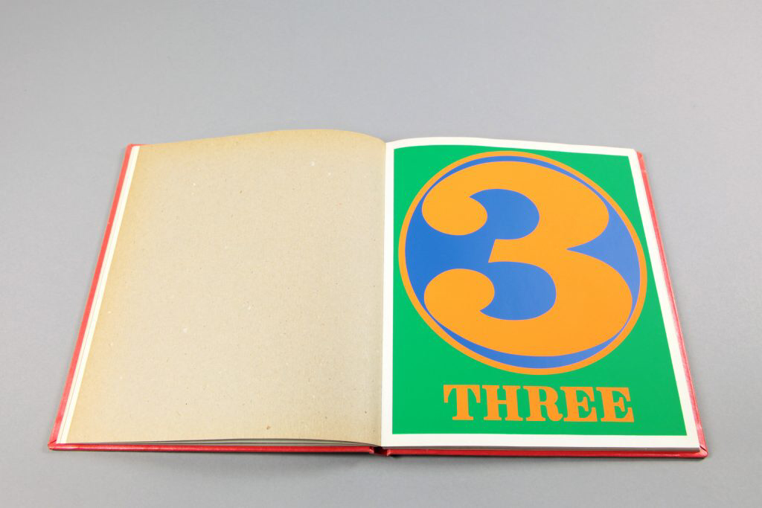
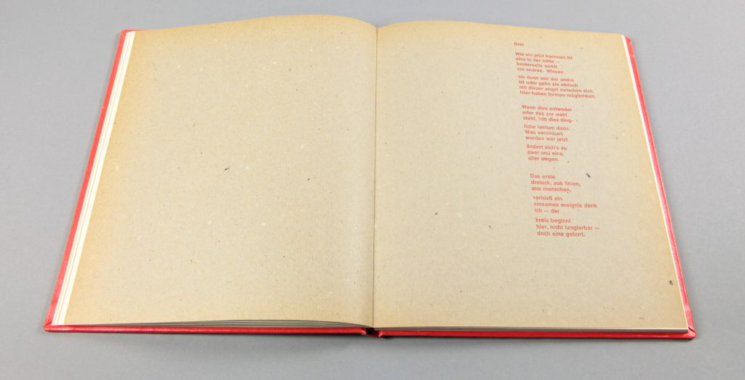

Slide 6
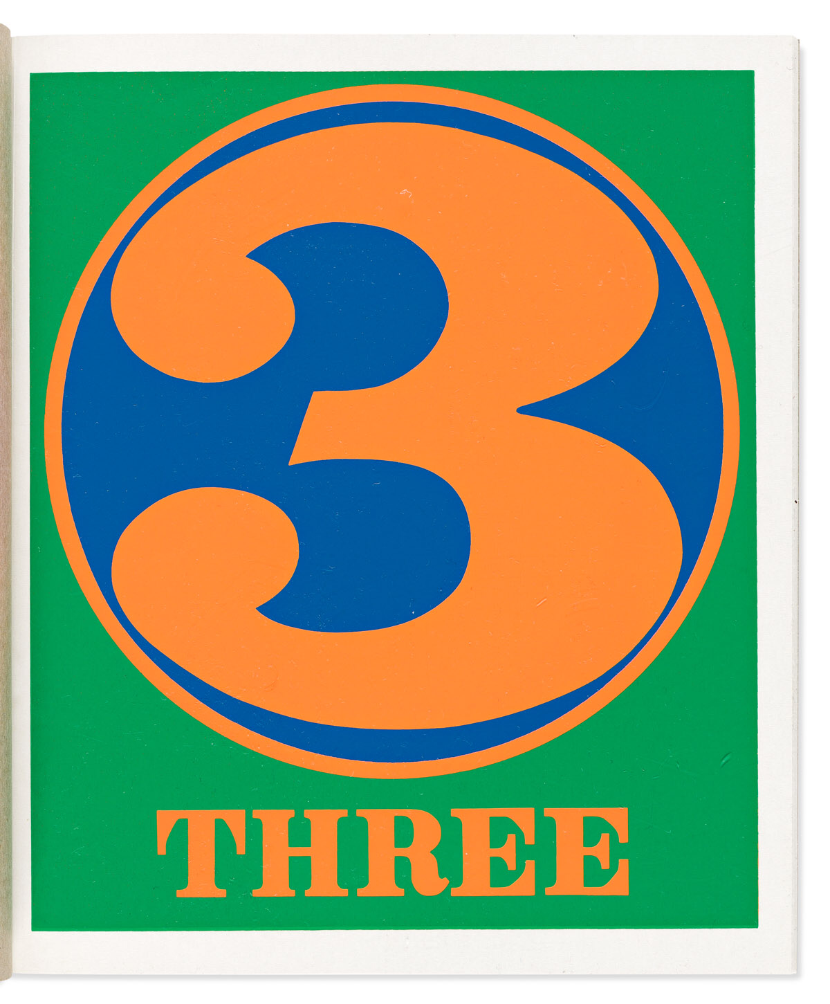
THREE
They come now with
one in the middle —
either side thus
another. …
Here forms have possibility.
*
When either this
or that becomes
choice, this fact
of things enters.

Slide 7
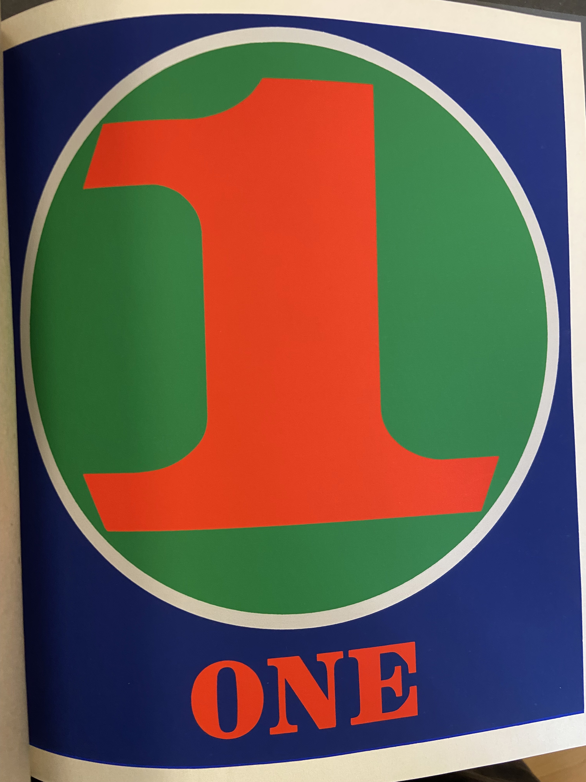
ONE
What
singular upright flourishing
condition . . .
*
Who was I that
thought it was
another one by
itself divided or multiplied
produces one.

Slide 8
NINE
There is no point
Of rest here.
It wavers,
it reflects multiply

Slide 9
FIVE
From each
of the four
corners draw
A line to
the alternate
points. Where
these intersect
will be
five.
*
A way to draw stars.

Slide 10
