Slide 1
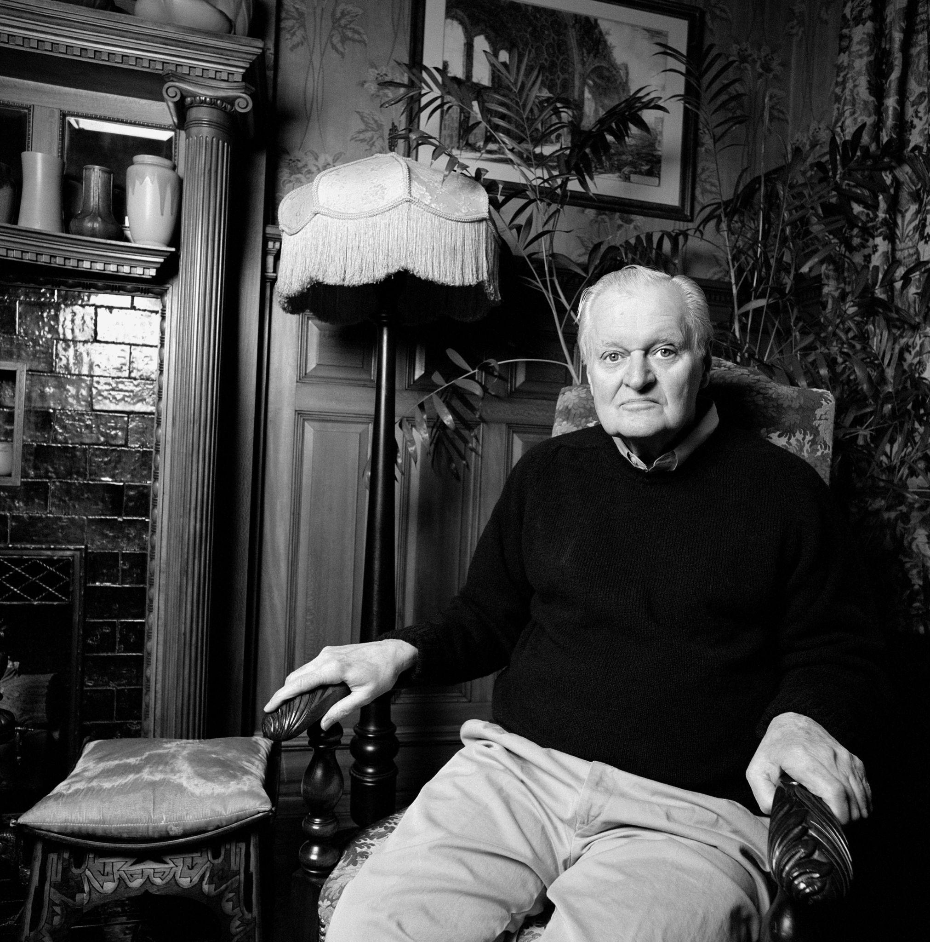
“In forgotten letters”: Open reading and Ashbery’s poetics of enclosure and disclosure
Dr. Heleina Burton May 2023

Slide 2
Open reading…
“...an ‘open’ situation, in movement. A work in progress.” Umberto Eco, from The Open Work (1962)
“...at once rhetorically open and reticent… [it] can enclose and disclose at the same time.” Catherine Imbriglio, ‘‘Our days put on such reticence’: The rhetoric of the closet in John Ashbery's ‘Some Trees’ (1995)

Slide 3
“Still, that poetry does sometimes occur
If only in creases in forgotten letters
Packed away in trunks in the attic…”
From ‘Grand Galop’ (1974)
“Unfortunately, I’m not very good at ‘explaining’ my work. I once tried to do this in a question-and-answer period with some students of my friend Richard Howard, after which he told me: ‘They wanted the key to your poetry, but you presented them with a new set of locks.’” From Other Traditions (The Charles Eliot Norton Lectures) (2001)

Slide 4
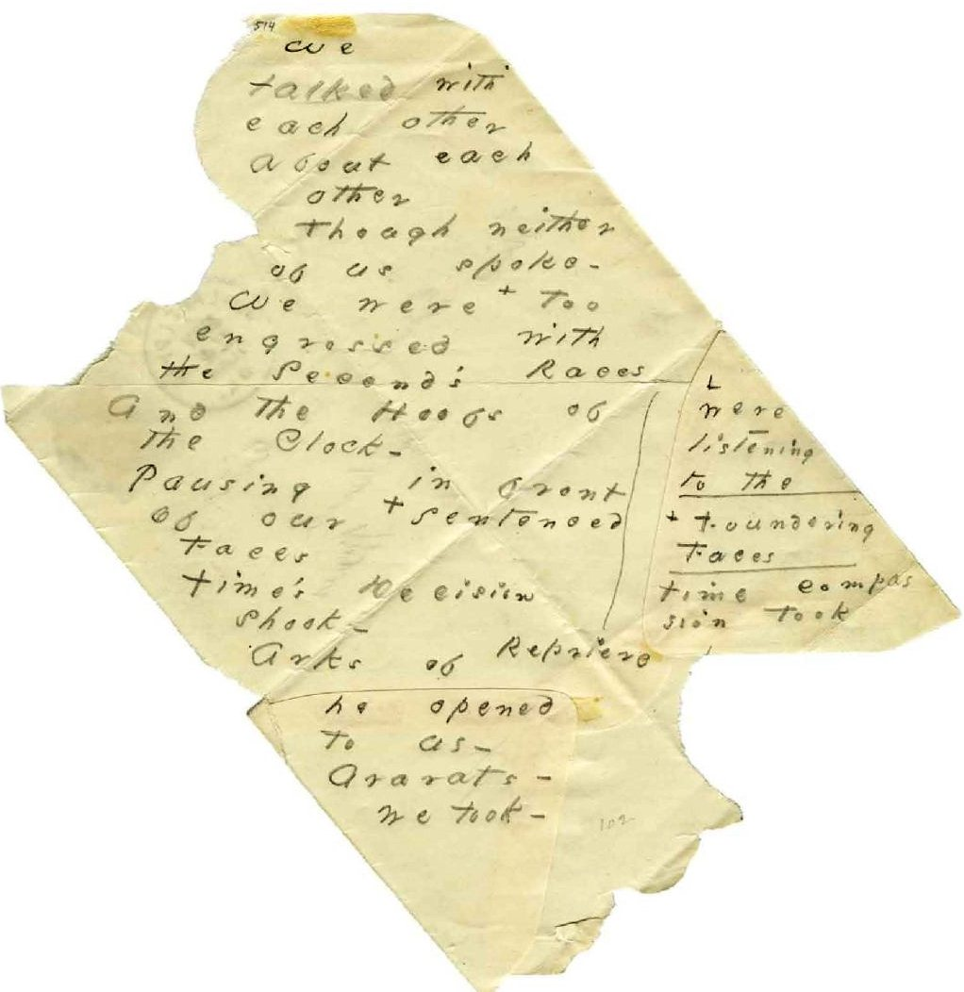
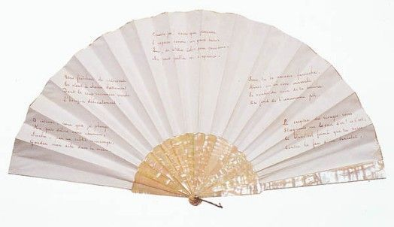
Stéphane Mallarmé, ‘Autre éventail de Mademoiselle Mallarmé’ (Another of Mademoiselle Mallarmé’s fans), 1884
Emily Dickinson, ‘We talked with each other about each other’, c. 1879,

Slide 5
“...linens folded in my scented cedar closets” From Flow chart (1991)
“Just before he left for college, at Harvard, his mother read one of his letters and discovered that he was gay. She brought it up one day in the car when the two of them were driving to visit a neighbor; she was very upset… But after that it seemed to him that she managed to forget the distressing information, for she continued to ask him about girlfriends as she always had, and never mentioned the subject again.”
From ‘Present waking life: Becoming John Ashbery’, interview with Larissa MacFarquhar, The New Yorker (2005)

Slide 6
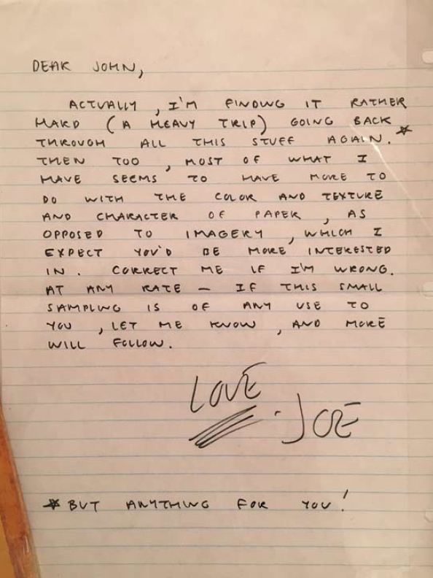
“...a letter on a tray whose message is to change everything.” From ‘Grand Galop’ (1974)
“…like waving to somebody who might have been waving to somebody behind you.” Ben Lerner, ‘The Reflection of a Reading’ (2007)

