Slide 1
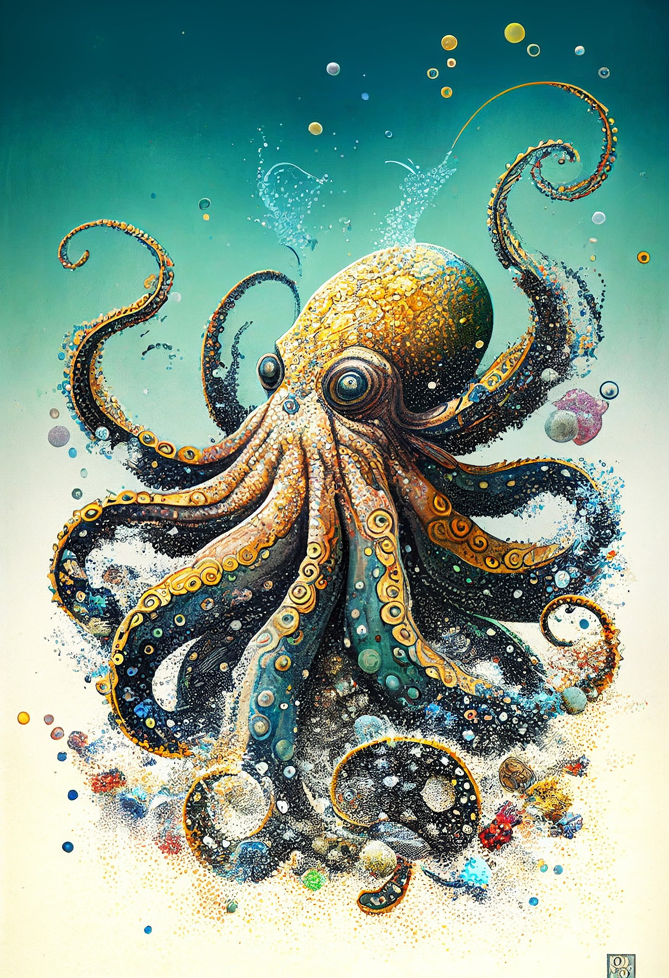


‘Tentacles in many different spheres’: Being
a small poetry press in the 21st century
Caroline Harris & Briony Hughes

Slide 2
‘I prefer to see the New York School as a very loose constellation of poets, artists, composers, etc, that spans several generations, and that has tentacles in many different spheres of culture and in different time periods’—Andrew Epstein, from Locus Solus: The New York School of Poets

Slide 3
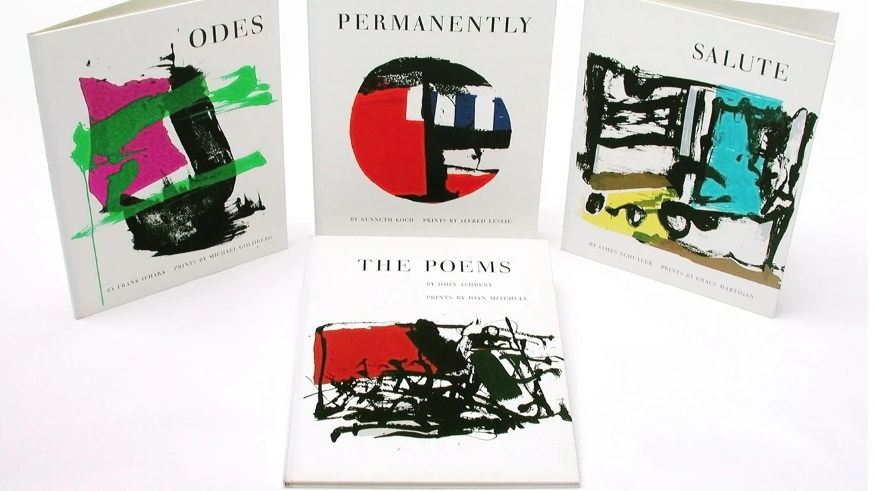

Slide 4
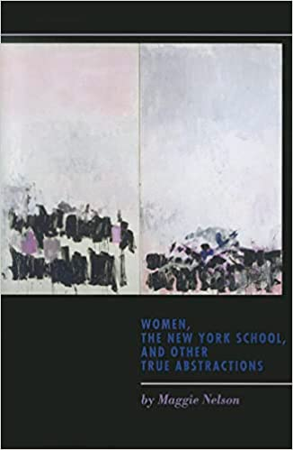
‘There has been a great deal of fluidity and affinity – personally, textually, and critically – between women writing in the New York School vein and women associated with language writing’—Maggie Nelson, from Women, the New York School, and Other True Abstractions

Slide 6
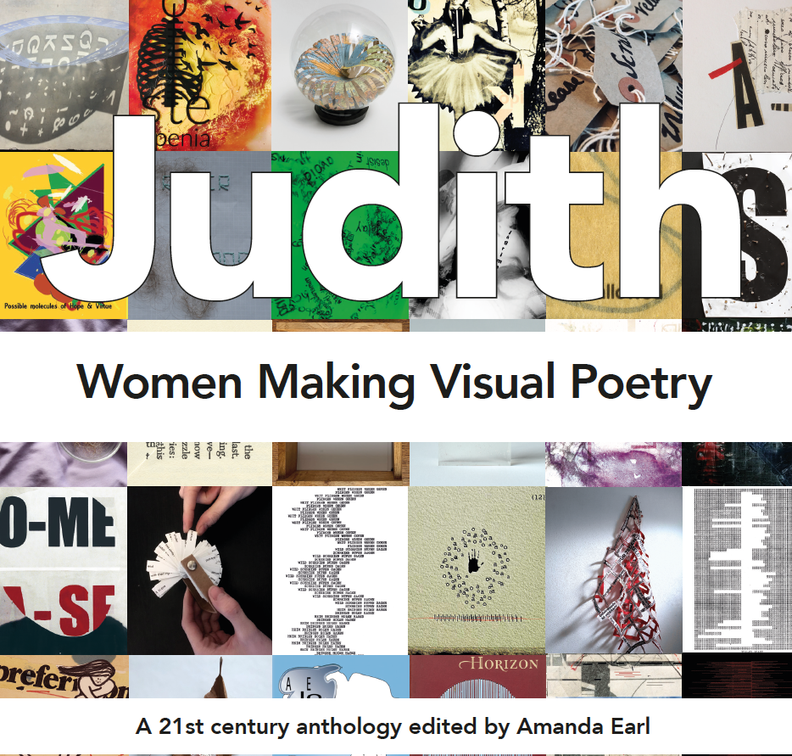
‘Over the years, I have been told numerous times by male publishers, editors, and visual poets that few women make visual poetry. And judging from visual poetry anthologies published in the twenty-first century, this appeared to be true…’—Amanda Earl, editor, in Judith: Women Making Visual Poetry

Slide 7
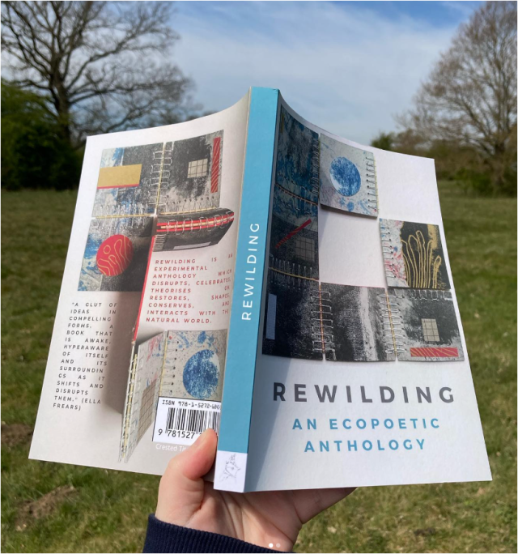
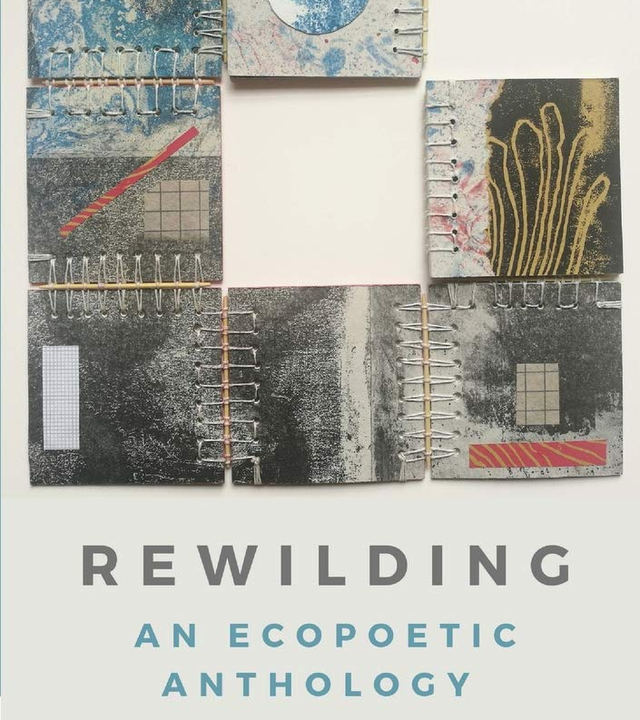

Slide 8
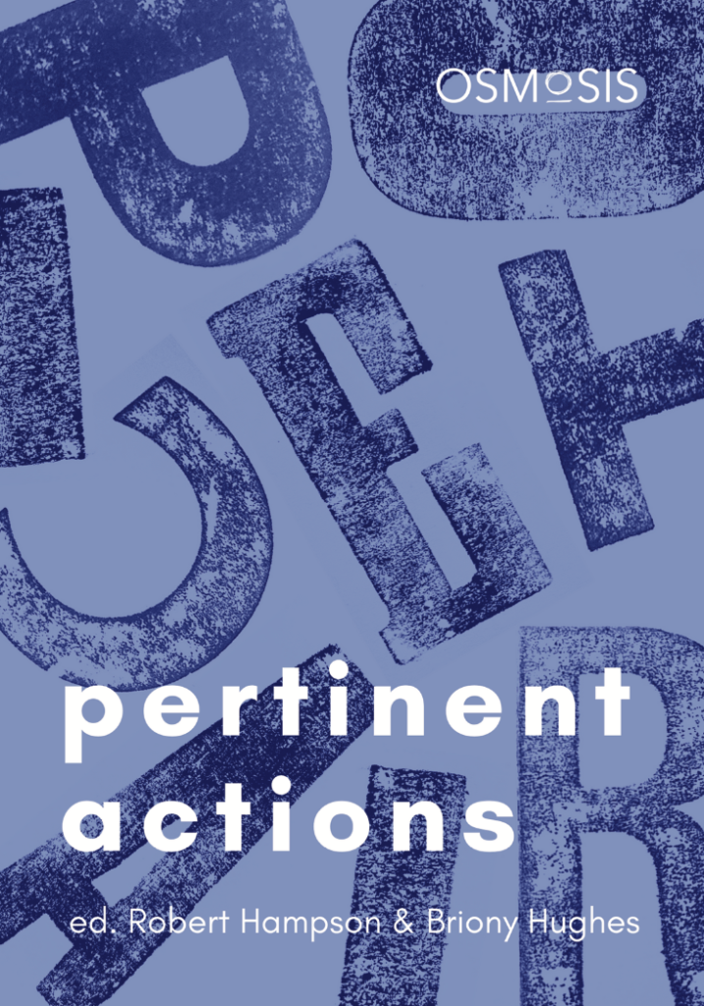
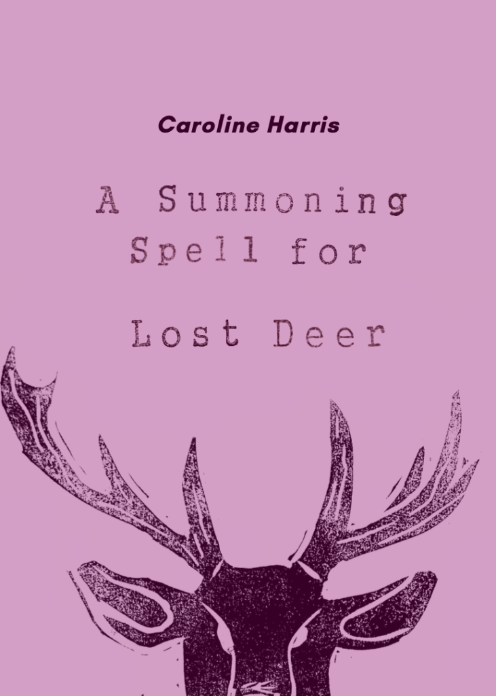
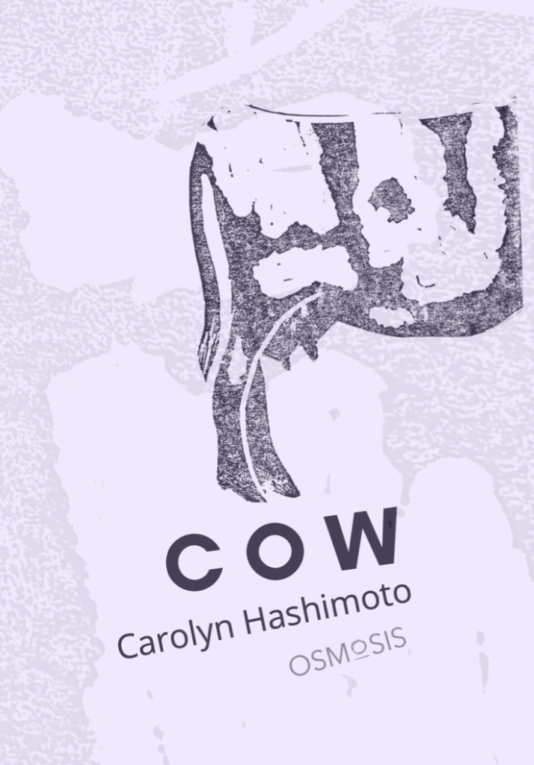

Slide 9
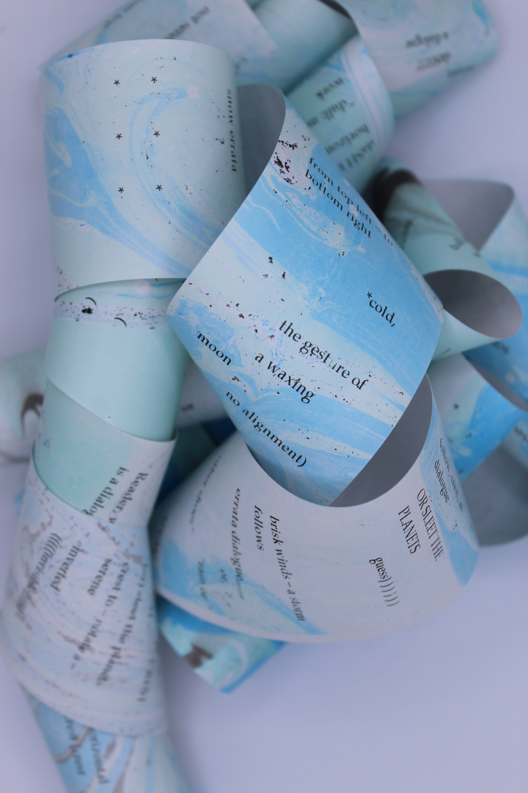

Slide 10


Slide 11
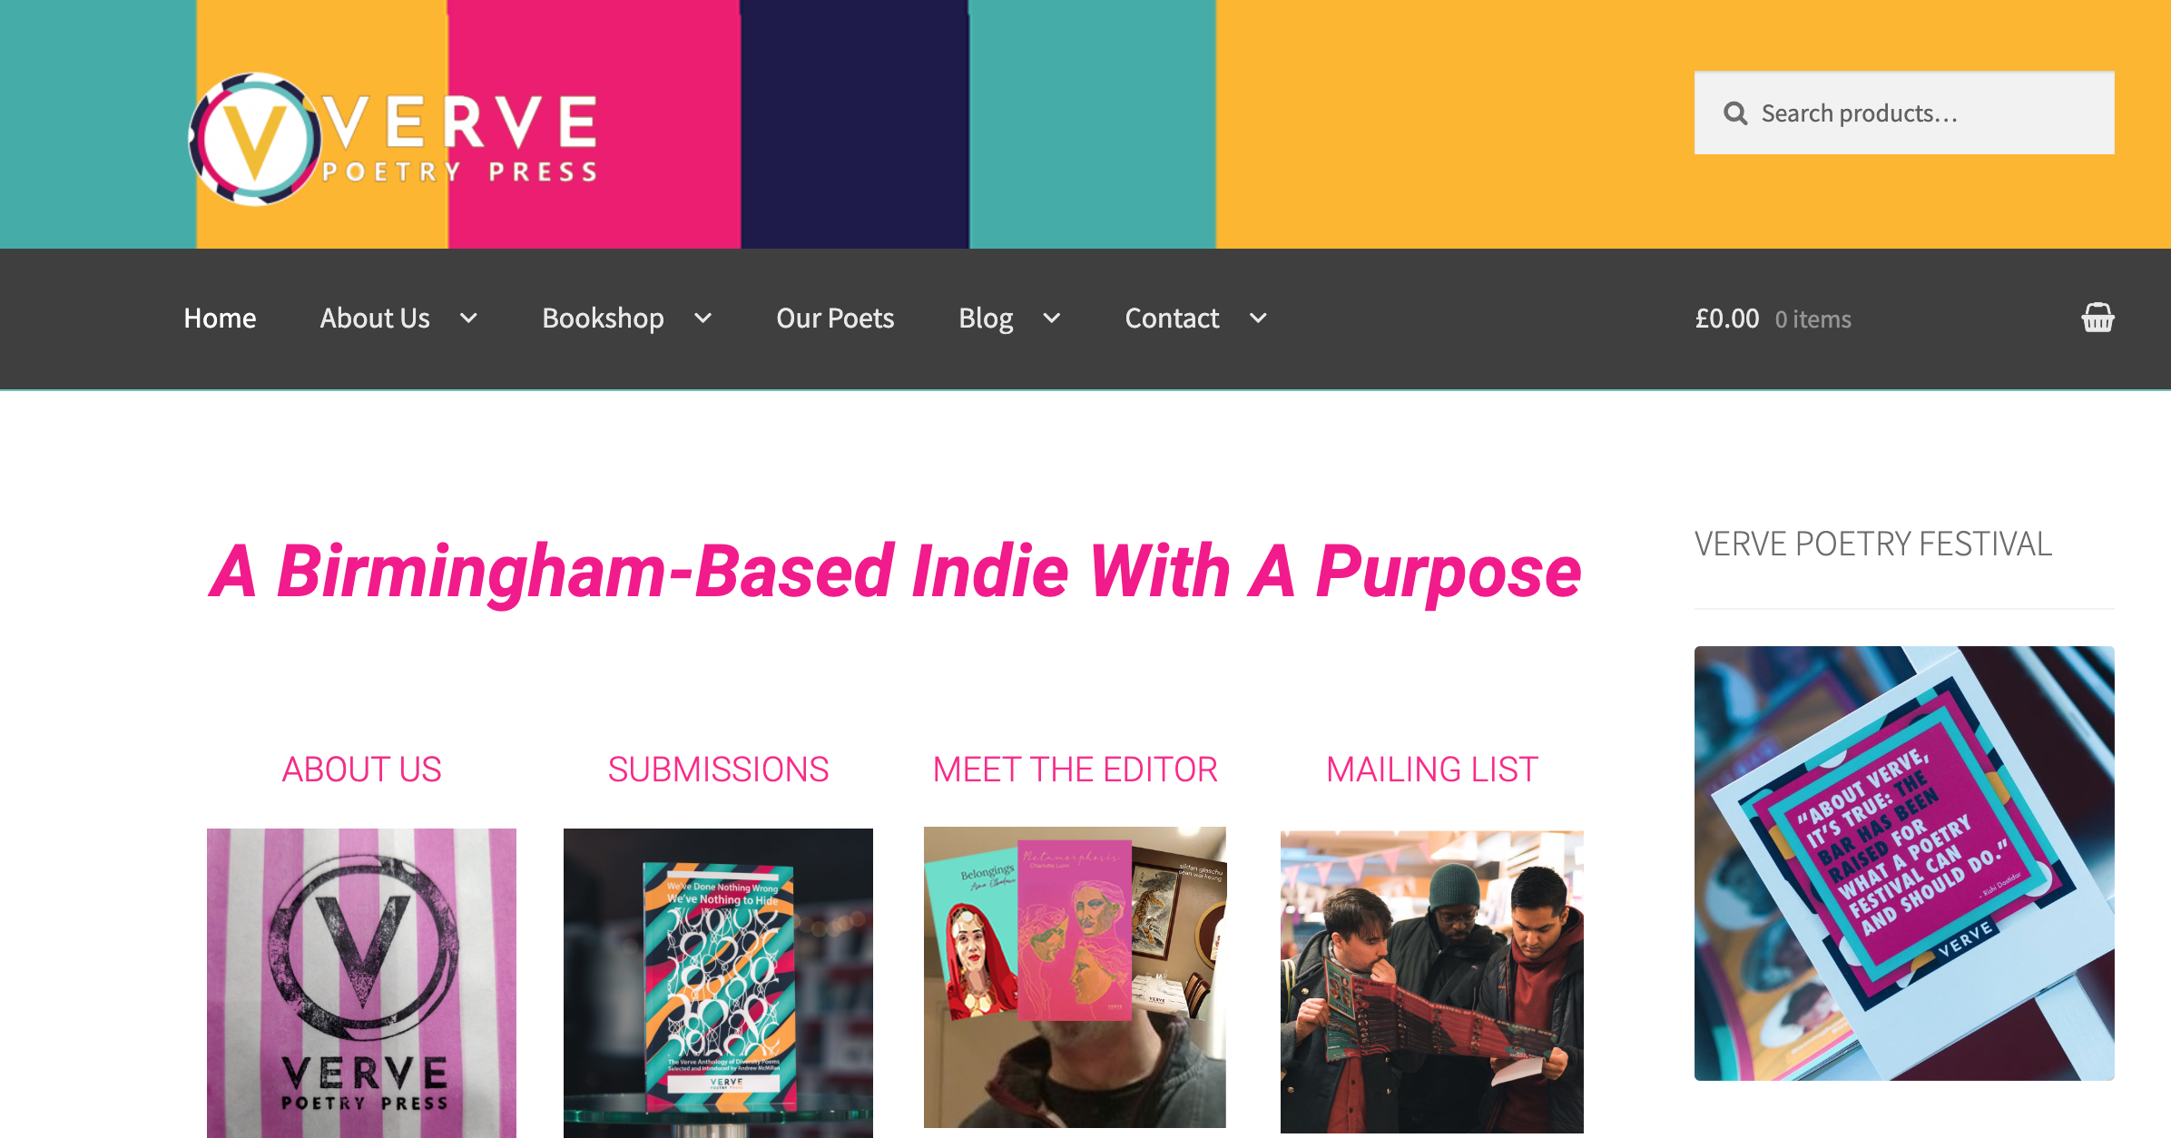

Slide 12
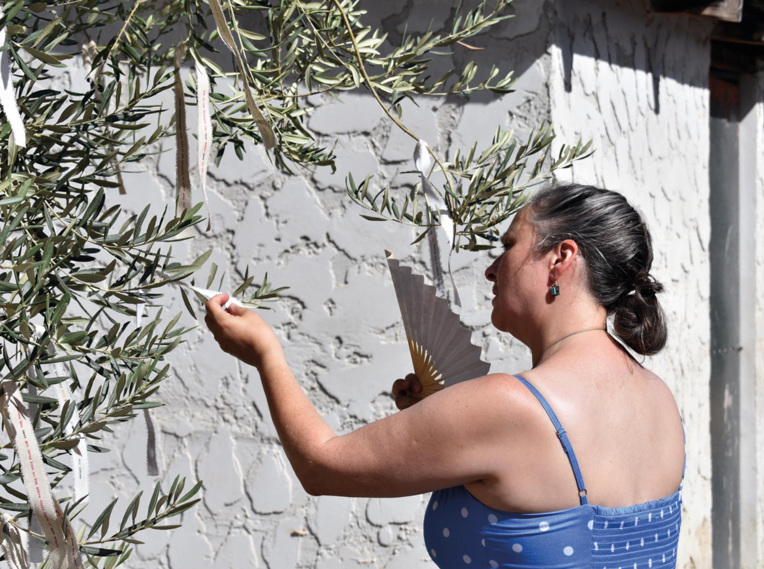
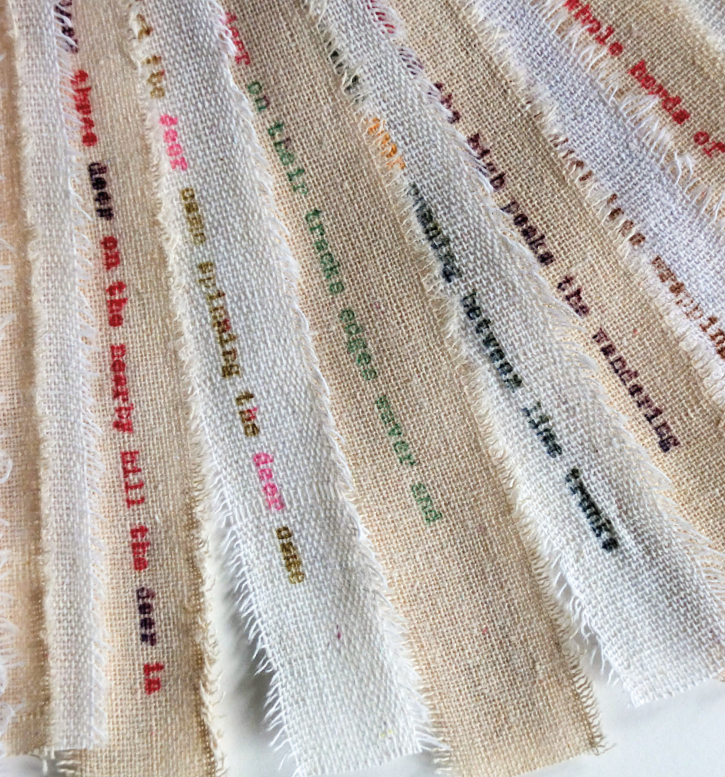

Slide 13
